Slide 1
Cost-effectiveness and Decision Modeling
Using R for decision modeling in health technology assessment.
CE16 NIHES
February, 2020

Slide 2
Building Decision Models in R
Notes:
Eline

Slide 3
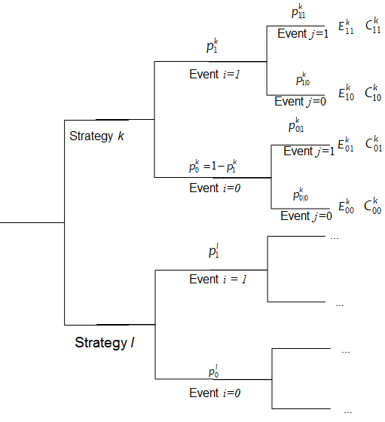
The Decision Tree

Slide 4

Inputting data in R
Input
: Probability of an event i in treatment k.
: Conditional probability of event j given event i in treatment k.
: Effectiveness associated with experiencing the combination of events i and j in treatment k.
: Costs associated with experiencing the combination of events i and j in treatment k.

Slide 5
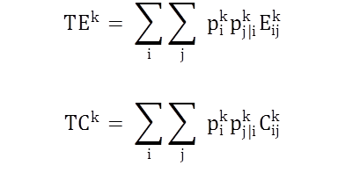
Conceptualizing a decision tree
Initialize TE , TC the vectors containing the total effectiveness and costs for all k strategies
The expected effectiveness and cost for each intervention can be described with one single equation

Slide 6

Conceptualizing a decision tree
Output
Incremental Costs: ΔC_{kl} = TC_{l} – TC_{k}
Incremental Effects: ΔΕ_{kl} = TE_{l} – TE_{k}
Incremental Cost Effectiveness Ratio:
ICER_{kl} =
Create graphical representations of the results (CE planes etc)

Slide 8
Outline
CEA and modeling overview
CEA milestones
Modeling advantages and disadvantages
Simple example of decision tree
Calculating incremental cost-effectiveness ratios (ICERs) and other metrics

Slide 9
CEA Overview
Decision/Policy Maker
Benefits
Harms
Costs
Perspective(s)
Interventions
Population
Comparator
Scope
Time horizon
Trial-based CEA
Sample size
Time horizon
Model-based CEA

Slide 10
Health Outcomes (CEA)
Disease-specific
Intermediate clinical markers
Cases averted
Events averted
Generic
Lives saved
Life years gained
Quality-adjusted life years (QALYs)

Slide 11
Quality-Adjusted Life Years
1.0
0.9
0.7
0.3
Time
0
2
3.5
4.5
7
← Life span →
QALYs =
(2)(1)
+(1.5)(.7)
+(1)(.3)
+(2.5)(.9)
= 5.6

Slide 12
Costs
Formal healthcare sector
Third-party payers
Out-of-pocket by patient
Informal healthcare sector
Patient time
Unpaid caregiver
Transportation costs
Non-healthcare sectors
Productivity/consumption
Legal or criminal justice
Education/housing

Slide 13
Costs vs. Health Effects
Incremental Cost
+
−
+
Evaluate
C/E
Ratio
Yes
Incremental
Health
Effect
−
Evaluate
C/E
Ratio
No

Slide 14
The Incremental C/E Ratio
Net Increase in Cost
Net Increase in Health Effect
A measure of “value for money”
Comparison of competing alternatives
Comparison across interventions

Slide 15
Some CEA Milestones (US)
1975 NEJM issue on MDM
1980 Pneumococcal vaccination is first covered preventive service by Medicare in part based on CEA
1989 HCFA (CMS) issues proposed regulations to consider CEA in coverage decisions
1990-94 Oregon Medicaid program issues ranked list of the cost-effectiveness of treatments
1996 Original Panel on Cost-Effectiveness in Health and Medicine
1999 HCFA withdraws proposed regulation to consider CEA in coverage decisions
2001 USPSTF considers a role for CEA on making recommendations
2003 OMB requires formal CBA for costly new regulations
2008 ACIP establishes guidelines for CEA
2010 ACA prohibits PCORI from using cost per QALY

Slide 16
Some CEA Milestones (International)
1993 Australia implements pharmacoeconomic guidelines to inform
1994 Canada’s first set of nation al pharmaceutical guidelines is published
1998 WHO established WHO CHOICE to assist with resource allocation in 14 world regions
1999 UK establishes NICE
2001 Australia’s PBAC rejects listing of Herceptin for breast cancer
2005 The Netherlands incorporated mandatory CEA in national decision making
2006 South Korea includes CEA for reimbursement decisions
2007 Germany adopts “efficiency frontier” approach
2012 France makes CEA mandatory for reimbursement

Slide 17
Decision Analysis
Explicit, quantitative and systematic approach to decision making under uncertainty
Identify, measure, and value the consequences of decisions as well as the uncertainty that exists when the decision needs to be made
Help structure the analysts’ thinking and facilitate the communication of assumptions
Provide a structural framework for synthesizing data from disparate sources and allows for extrapolation
Elements are incorporated into a model to structure the decision problem over time, and used to compare the outcomes of different options or interventions

Slide 18
Probability
of disease
Health-related
quality of life
Efficacy of treatment
Risks of treatment
Decision
model
Risk of future events
Adherence
Costs
Test characteristics
Health & economic
outcomes for
alternative strategies
Policy
Implications

Slide 19
Decision Tree (a type of model)
Schematic representation of all of the important outcomes of a decision (e.g., clinical, economic, non-health sectors)
Used to combine knowledge about decision problem from many sources
Computes average outcomes (e.g., costs, events, QALYs) from decisions

Slide 20
Advantages and Disadvantages of Decision Models

Slide 21
Advantages of modeling
Clarifies decision-making
Provides comprehensive framework
Allows best available data to be applied
Allows explicit and systematic characterization and treatment of uncertainty
Extrapolates short-term observations into long-term outcomes
Encourages “what if” analyses

Slide 22
Extend Beyond Time Horizon
Can “translate” an intermediate endpoint (e.g., increase in CD4 count, decrease in blood pressure) into clinical endpoints such as life years saved or quality-adjusted life years gained
Incorporates important long-term effects of treatment

Slide 23
Example: DCCT
Patients
with
IDDM
Retinopathy
Nephropathy
Neuropathy
Blindness
ESRD
Amputation
Clinical
Trial Data
Model
DCCT Research Group. JAMA. 1996;276:1409-1415.

Slide 24
Consider All Relevant Strategies
Comparison of interventions often not compared head-to-head in a trial.
Clinical trials do not always consider those strategies which would be most relevant in a cost-effectiveness analysis.
Too many plausible strategies to be feasible for a clinical trial.

Slide 25
Incremental Analysis
40,000
C
30,000
$35,000/QALY
Cost ($)
20,000
$60,000/QALY
10,000
A
B
$10,000/QALY
0
8
8.5
9
Effectiveness (QALYs)

Slide 26
“What If” Scenarios
Identifies important gaps in our knowledge
What would the diagnostic accuracy of a noninvasive imaging test for coronary arteries have to be to replace the tests used in current practice?
How effective does a treatment need to be, and at what duration of treatment effect, to replace current therapy?

Slide 27
Disadvantages of modeling
Validation issues
Problem may be incorrectly specified
May ignore important nuances that do not lend themselves well to modeling
Inputs may be biased
Communication issues
Outputs can be difficult to interpret and may not be directly relevant to decision-makers
Transparency
Trust

Slide 28
Simple Decision Tree
Viral encephalitis can be caused by herpes virus (HVE) or other viruses (OVE); Pr(HVE) = 52%.
Untreated HVE leads to death or severe sequelae in 71%; for OVE the figure is 1%.
A drug, vidarabine, decreases mortality or severe sequelae due to HVE from 71% down to 36%.
Side effects cause an increase in mortality among OVE patients treated with vidarabine from 1% to 20%.

Slide 29
To treat or not to treat
HVE
0.36
0.52
Treat
0.48
OVE
0.20
HVE
0.71
0.52
Do not treat
0.48
OVE
0.01
Outcome = Pr(mortality or severe sequelae)

Slide 30
0.52*0.36 + 0.48*0.20 = 0.2832
HVE
0.36
0.52
Treat
0.48
OVE
0.20
HVE
0.71
0.52
Do not treat
0.48
OVE
0.01

Slide 31
0.52*0.36 + 0.48*0.20 = 0.2832
HVE
0.36
0.52
Treat
0.48
OVE
0.20
HVE
0.71
0.52
Do not treat
0.48
OVE
0.01
0.52*0.71 + 0.48*0.01 = 0.3740

Slide 32
One-Way Sensitivity Analysis
Expected Value of p(HVE) = 0.52

Slide 33
Threshold Analysis
Threshold p(HVE) = 0.35

Slide 34
There is a third option
It is possible to obtain a definitive diagnosis by means of brain biopsy, but this procedure itself carries a rate of mortality or severe sequelae of 5%.

Slide 35
0.2832
HVE
0.36
0.52
Treat
0.48
OVE
0.20
0.3740
HVE
0.71
Do not treat
0.52
0.48
OVE
0.01
Biopsy

Slide 36
0.2832
HVE
0.36
0.52
Treat
0.48
OVE
0.20
0.3740
HVE
0.71
Do not treat
0.52
0.48
OVE
0.01
Survive
Biopsy
0.95
0.05
Biopsy death

Slide 37
0.2832
HVE
0.36
0.52
Treat
0.48
OVE
0.20
0.3740
HVE
0.71
0.52
Do not treat
0.48
OVE
0.01
HVE
0.36
Survive
0.52
Biopsy
0.95
0.48
OVE
0.01
0.05
Biopsy death
1.00

Slide 38
0.2832
HVE
0.36
0.52
Treat
0.48
OVE
0.20
0.3740
HVE
0.71
0.52
Do not treat
0.48
OVE
0.01
0.1920
HVE
0.36
Survive
0.52
Biopsy
0.95
0.48
OVE
0.01
0.05
Biopsy death
1.00

Slide 39
0.2832
HVE
0.36
0.52
Treat
0.48
OVE
0.20
0.3740
HVE
0.71
0.52
Do not treat
0.48
OVE
0.01
0.1920
0.2324
HVE
0.36
Survive
0.52
Biopsy
0.95
0.48
OVE
0.01
0.05
Biopsy death
1.00

Slide 40
One-Way Sensitivity Analysis

Slide 41
A CEA Example
Notes:
Part 1 = Showing code 3 state model
Part 2 = Exercise build Sick-Sicker model
Part 3 = Show answers of Sick-Sicker

Slide 42
Herceptin® (trastuzumab) for Metastatic Breast Cancer
Given in combination with chemotherapy
Only benefits patients whose tumors overexpress HER2/neu protein (20-30% of patients) and costs ~$4500/3 week cycle
There are a number of different tests to identify HER2 overexpressers
What’s the optimal testing strategy?
Elkin EB et al. Journal of Clinical Oncology 2004

Slide 43
Available Tests
Immunohistochemical assays (IHCs) for protein overexpression (HercepTest)
Less accurate, less costly
Fluorescence in situ hybridization (FISH) for gene amplification
Accepted gold standard, 3x more costly than HercepTest

Slide 44
Five Strategies Evaluated
1. No HercepTest, no Herceptin
2. HercepTest, Herceptin to 3+
3. HercepTest, Herceptin to 3+, FISH 2+
4. HercepTest, Herceptin to 2+ or 3+
5. FISH, Herceptin for positive results

Slide 45
Herceptin is effective in patients who overexpress HER-2
Herceptin increases response rate (50% vs. 32%)
Herceptin extends median duration of response (9.1 months vs. 6.1 months)
Herceptin improves one-year survival (73% vs. 61%)

Slide 46
Herceptin is not effective in patients who are FISH negative
Response Rate by FISH Result
FISH+ FISH−
(n=241) (n=95)
C alone 27% 39%
C + Herceptin 54% 41%

Slide 47
Results: Costs and Effects
Strategy QALYs Cost
No test, chemo 1.29 $53,413
HT, treat 3+ 1.36 $65,867
HT, treat 3+, FISH 2+ 1.37 $74,100
HT, treat 2+ & 3+ 1.37 $68,461
FISH, treat + 1.38 $68,150
Simple Dominance

Slide 48
Results
Strategy QALYs Cost ICER*
No test, chemo 1.29 $53,413 -
HT, treat 3 1.36 $65,867 $178K/QALY
FISH, treat + 1.38 $68,150 $114K/QALY
*ICER = ΔCost/ΔQALY compared with next best strategy

Slide 49
Results
Strategy QALYs Cost ICER*
No test, chemo 1.29 $53,413 -
HT, treat 3 1.36 $65,867 $178K/QALY
FISH, treat + 1.38 $68,150
$161K/QALY
Weak Dominance

Slide 50
Net Monetary Benefit (NMB) (WTP threshold)
Strategy NMB ($) ($100K/QALY) ($200K/QALY)
No test, chemo 75,587 204,587
HT, treat 3+ 70,133 206,133
HT, treat 3+, FISH 2+ 62,900 199,900
HT, treat 2+ & 3+ 68,539 205,539
FISH, treat + 69,850 207,850
NMB = QALYs*WTP - Cost

Slide 51
Graphical Representations of CEA Output

Slide 52
Modeling for USPSTF
Many different colorectal cancer screening strategies
Age to begin screening
Age to end screening
Screening interval
Screening modality
Costs NOT allowed!!
Life years gained and colonoscopies required

Slide 53
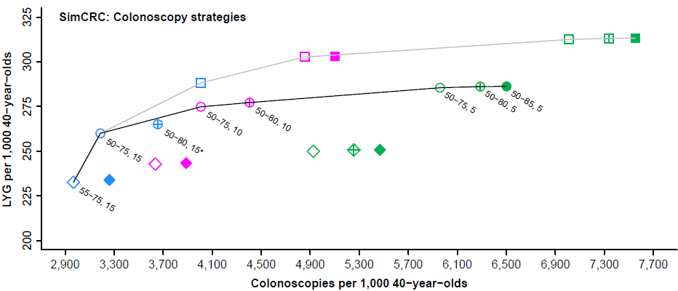
USPSTF Recommendations for 2016 Decision Analysis for Colonoscopy
Interval (color)
Age to begin-age to end screening (symbol)
Efficient frontier
15
45-75y
45-80y
45-85y
With age to begin 45, 50 or 55
10
50-75y
50-80y
50-85y
With age to begin 50 or 55
5
55-75y
55-80y
55-85y
Labeled strategies are efficient or near-efficient with age to begin 50 or 55. * indicates strategy is near-efficient (LYG within 98% of the efficient frontier).
Knudsen AB, et al.; JAMA, Vol. 315 No. 23, June 21, 2016

Slide 54
CEA of Lumacaftor-Ivacaftor for Cystic Fibrosis

Slide 55
Probabilistic Sensitivity Analysis
Inputs
Model
Outputs
x
1
Effect
x
NMB
2
Cost
x
i

Slide 56
Luma-Iva vs. Best Supportive Care for CF

Slide 57
Example with More Uncertainty
Δ Cost
Δ Effectiveness

Slide 58
CE Acceptability Curve

Slide 59
Decision Tree Example
Evaluate the cost-effectiveness of three follow-up strategies for colorectal cancer after treatment (Gray et al, 2011):
Follow-up in primary care (PC)
Follow-up in hospital care (HC)
Continue routine practice (RP)
Strategies differ in:
Probability of early detection (ed) vs. late detection (ld) of colorectal cancer recurrence
Early detection has higher life-expectancy than late
Follow-up costs (C) in UK pounds

Slide 60
Decision Tree Example
Parameters | Variable Name in R | Value
Probability of early detection
Follow-up in primary care (PC) | p_PCed | 0.40
Follow-up in hospital care (HC) | p_HCed | 0.45
Routine practice (RP) | p_RPed | 0.35
Life expectancy (Years)
Early detection | le_ed | 7
Late detection | le_ld | 1
Total healthcare costs (Follow-up and treatment - $)
Early detection in PC | c_PCed | 3900
Early detection in HC | c_HCed | 6200
Early detection in RP | c_RPed | 3030
Late detection in PC | c_PCld | 12800
Late detection in HC | c_HCld | 14400
Late detection in RP | c_RPld | 12020

Slide 61
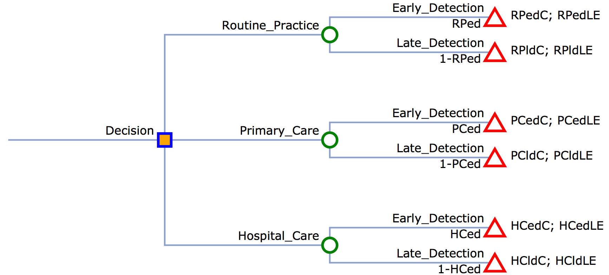
Example Decision Tree
c_RPed; e_Rped
c_RPld; e_RPld
c_PCed; e_Pced
c_PCld; e_PCld
c_HCed; e_Hced
c_HCld; e_HCld
Decision tree made in myopenTree.com

Slide 62
R Session
Notes:
Part 1 = Showing code 3 state model
Part 2 = Exercise build Sick-Sicker model
Part 3 = Show answers of Sick-Sicker

